Slide 1
CPE 133
Review
Design Approaches: Modular Design
New Device: Multiplexors

Slide 2
Important Comment
BBD = black box diagram
Include for every experiment
Include top two levels (unless specified otherwise)
Verilog Code
Start commenting code
Use proper header (the one given)
Names
Description of file
Answering Questions
Always try to draw diagram

Slide 3
Concurrency
Major aspect of HDL modeling
It’s hardware design
Hardware is inherently parallel
Behavioral modeling
Continuous assignment
Use for gate-level modeling
Always blocks
Describes functionality of circuit

Slide 4
All I know about Digital Design
Digital design is based on a relatively small set of digital devices.
Digital design relies heavily on various modeling approaches
Digital design modeling relies heavily on hierarchical modeling

Slide 5
Digital Design Foundation Modeling (DDFM)
Digital Design: using digital circuits to solve problems
Digital Circuit: a set of modules that exchange information under the control of “something”
Structured Design: any digital circuit can be built using a set of “foundation modules”
Foundation Modules:
Simple to understand at a high-level
Categorized as either a “controlled” or “controller” circuit
Four Ways to Control a Circuit: 1) none, 2) internal, 3) external, and 4) circuit
Three Design Approaches:
Brute Force (BFD),
Iterative Modular (IMD),
Modular (MD)

Slide 6
The Big Digital Design Picture

Slide 7
Foundation Modules (thus far)
RCA
Generic Decoder
Standard Decoder

Slide 8
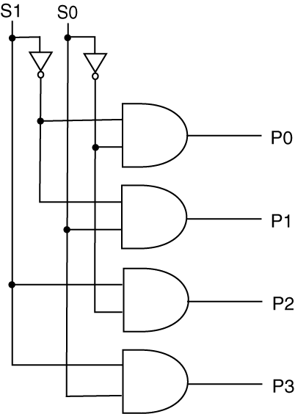
Standard Decoder
Only one AND gate at a time is non-dead
Outputs 1-hot code

Slide 9
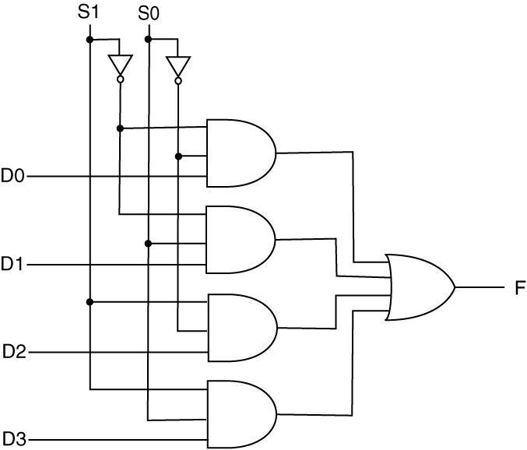
4:1 Multiplexor (MUX)
Alive AND gate “passes” Dx input value to output F
Dead AND gates do not affect F output as they provide ‘0’s to the output OR gate
S1 & S0 inputs “select” which D input will appear on F output

Slide 10
MUX Overview
MUX is a “selector” circuit
selects one of many inputs to the MUX to appear on the output of the MUX
General Forms: Binary Relationship
2:1, 4:1, 8:1, 16:1, etc.
Straight-forward to model in VHDL
Can select between single signals or bundles
Any design that “chooses” or “selects” between several “things” uses a MUX

Slide 11
MUX Foundation Module
4:1 MUX

Slide 12
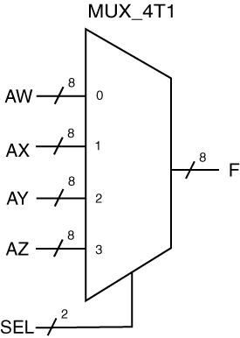
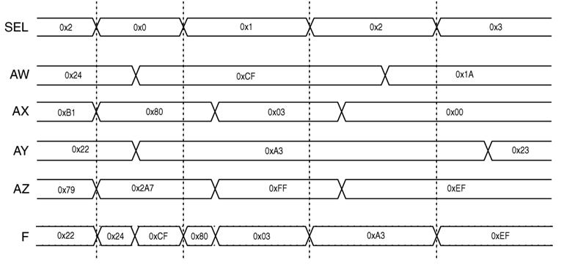
MUX Example

Slide 13
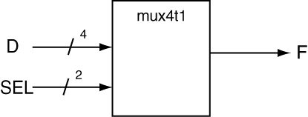
Verilog MUX Models
module mux_4t1_a(SEL, D, F);
input [1:0] SEL;
input [3:0] D;
output reg F;
always @(SEL, D)
begin
if (SEL == 0) F = D[0];
else if (SEL == 1) F = D[1];
else if (SEL == 2) F = D[2];
else if (SEL == 3) F = D[3];
else F = 0;
end
endmodule

Slide 14
Verilog MUX Models
module mux_4t1_b(SEL, D, F);
input [1:0] SEL;
input [3:0] D;
output reg F;
always @(SEL, D)
case (SEL)
0: F = D[0];
1: F = D[1];
2: F = D[2];
3: F = D[3];
default F = 0;
endcase
endmodule

Slide 15
Verilog 4:1 MUX Model
module mux_4t1_d(SEL, AW, AX, AY, AZ, F);
input [1:0] SEL;
input [7:0] AW, AX, AY, AZ;
output reg [7:0] F;
always @(SEL, AW, AX, AY, AZ)
case (SEL)
0: F = AW;
1: F = AX;
2: F = AY;
3: F = AZ;
default F = 0;
endcase
endmodule

Slide 16
Modular Design
Three Steps
0) Read and understand the problem
1) Draw the high-level block diagram
One block with all inputs and outputs
From problem statement
2) Draw the lower-level block diagram
As many blocks as you need
From problem statement
3) Connect the interior blocks as required
If you use a non-standard digital device, you need to provided a complete description of it
Define decoders with table

Slide 17
Design Example 1:
Design a circuit that adds two 8-bit unsigned binary inputs and provides an 8-bit output. If the result of the addition is valid, the circuit output the sum as an 8-bit unsigned value; otherwise, the circuit outputs zero.
Provide two levels of BBDs
State how circuit is controlled

Slide 18
Design Example 2:
Design a circuit that adds two 8-bit signed binary inputs. If the result of the addition is valid, the circuit output the sum as an 8-bit signed binary value; otherwise, the circuit outputs zero. All inputs and outputs are in RC format.
Provide two levels of BBDs
State how circuit is controlled

Slide 19
Design Example 3:
Design a circuit that has two 8-bit unsigned binary inputs A & B, and one 8-bit unsigned binary output F1. The circuit adds A+B.
If the button input is not pressed, the circuit always outputs the sum of A+B.
If the button is pressed, the circuit outputs A+B if the 8-bit output is valid, or outputs zero otherwise.
Provide two levels of BBDs
State how circuit is controlled

Slide 20
Design Problem Example 4
Design a circuit that has two 8-bit unsigned binary inputs A & B. If the sum of A+B is less than 127, the circuit outputs A; otherwise the circuit outputs B. Assume the result of the addition is always valid.
Show top two levels of BBD
State how circuit is controlled

